Slide 1


Kethavath Tarun Naik
Name of Project :
Smart Automation Irrigation Using Soil Moisture and Weather data
Name of Student:
KETHAVATH TARUN NAIK
AICTE Student ID:
STU67998b62a94131738115938
AICTE Internship ID:
INTERNSHIP_1748923002683e727a876ea

Slide 2

Learning Objectives
To develop a machine learning model for smart crop recommendation.
To analyze environmental parameters like temperature, humidity, pH, soil moisture, and rainfall.
To create a Streamlit-based app for easy local deployment and user interaction.
To apply data science techniques to improve water efficiency in agriculture.
To document and manage the project using GitHub for version control and collaboration.
GOAL
Source :
www.freepik.com/

Slide 3
Tools and Technology used
Programming Language: Python
Libraries:
Pandas – for data handling
Numpy – for numerical operations
Scikit-Learn – for building the ML model
Pickle – for saving the trained model
Streamlit – for creating the web app
IDE : Jupyter Notebook , VS Code
Version Control : GitHub

Slide 4
Methodology
Data Collection :
Collected environmental data such as temperature, humidity, moisture, pH, and rainfall from a .CSV file
Data Preprocessing :
Cleaned the data and selected important features for model training.
Model Building:
Used the Random Forest Classifier from Scikit-learn to train the model for crop prediction.
Model Saving:
Saved the trained model using Pickle for future use.
App Development:
Created a user interface using Streamlit where users can input values and get predictions.
Version Control:
Managed the project using GitHub to track code and updates.

Slide 5
Problem Statement:
Farmers often face difficulty in selecting the right crop due to changing weather conditions and lack of proper data.
Traditional irrigation methods can lead to overuse or underuse of water, affecting crop yield and soil health.
There is a need for a smart system that can help in making data-based decisions using environmental factors like temperature, humidity, pH, soil moisture, and rainfall.
A solution is needed that is easy to use, efficient, and can be accessed locally without complex setup.

Slide 6
Solution:
We developed a Smart Irrigation System using 19 sensors to collect environmental data like temperature, humidity, moisture, rainfall, and pH.
A machine learning model processes this data to predict the best crop for the conditions.
The system also controls 3 water pumps, which automatically switch ON or OFF based on the sensor values and prediction results.
A Streamlit app allows users to input values and see real-time predictions and decisions.
All code and documentation are maintained on GitHub for easy access and version control.
GitHub : https://github.com/tarunnaik9/Smart_Irrigation_AICET_Shell.git

Slide 7
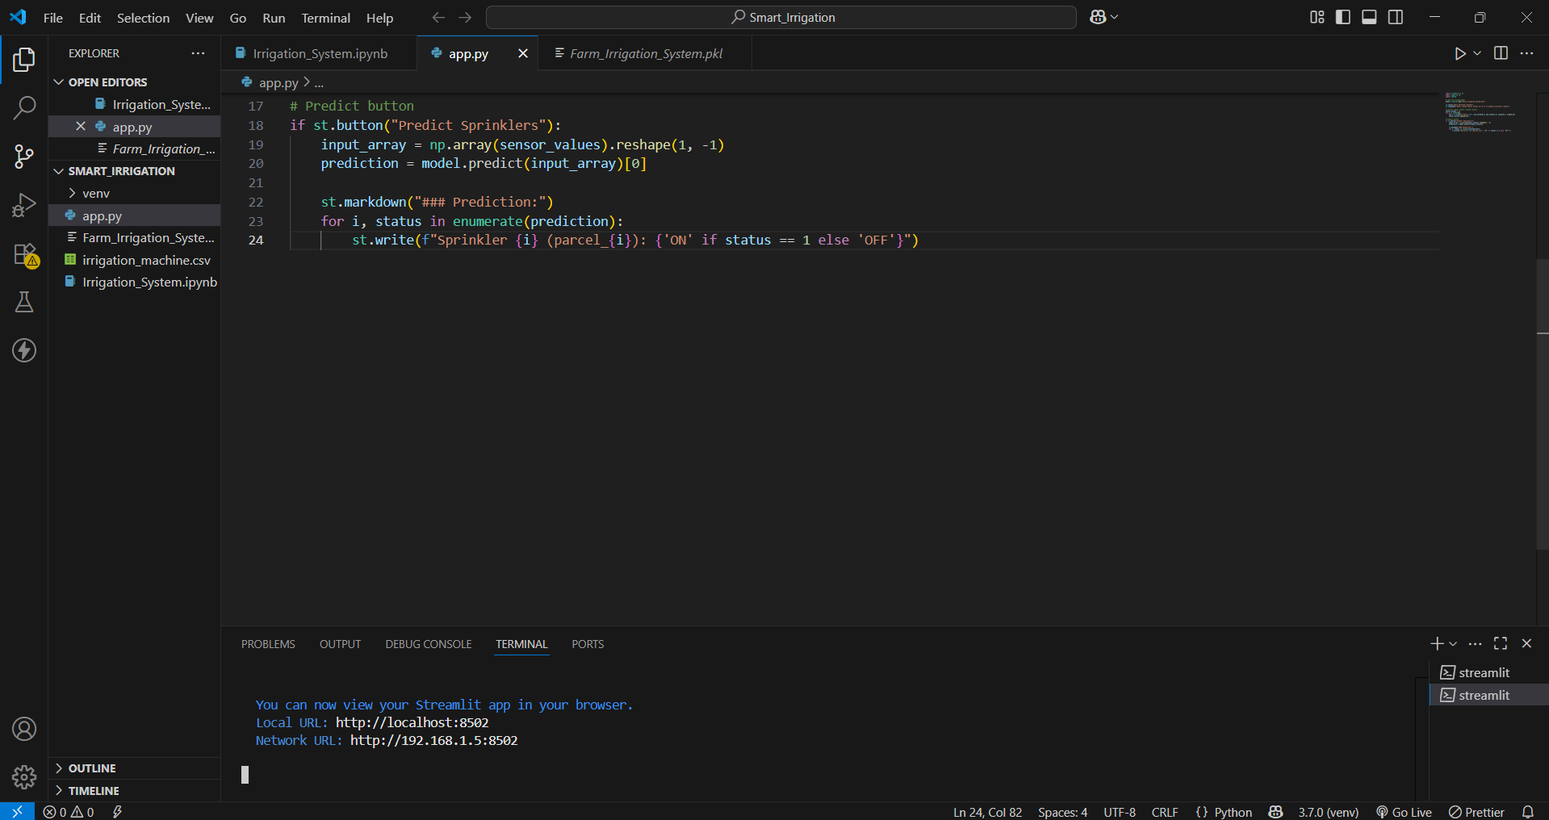
Screenshot of Output:
VS Code running app.py

Slide 8
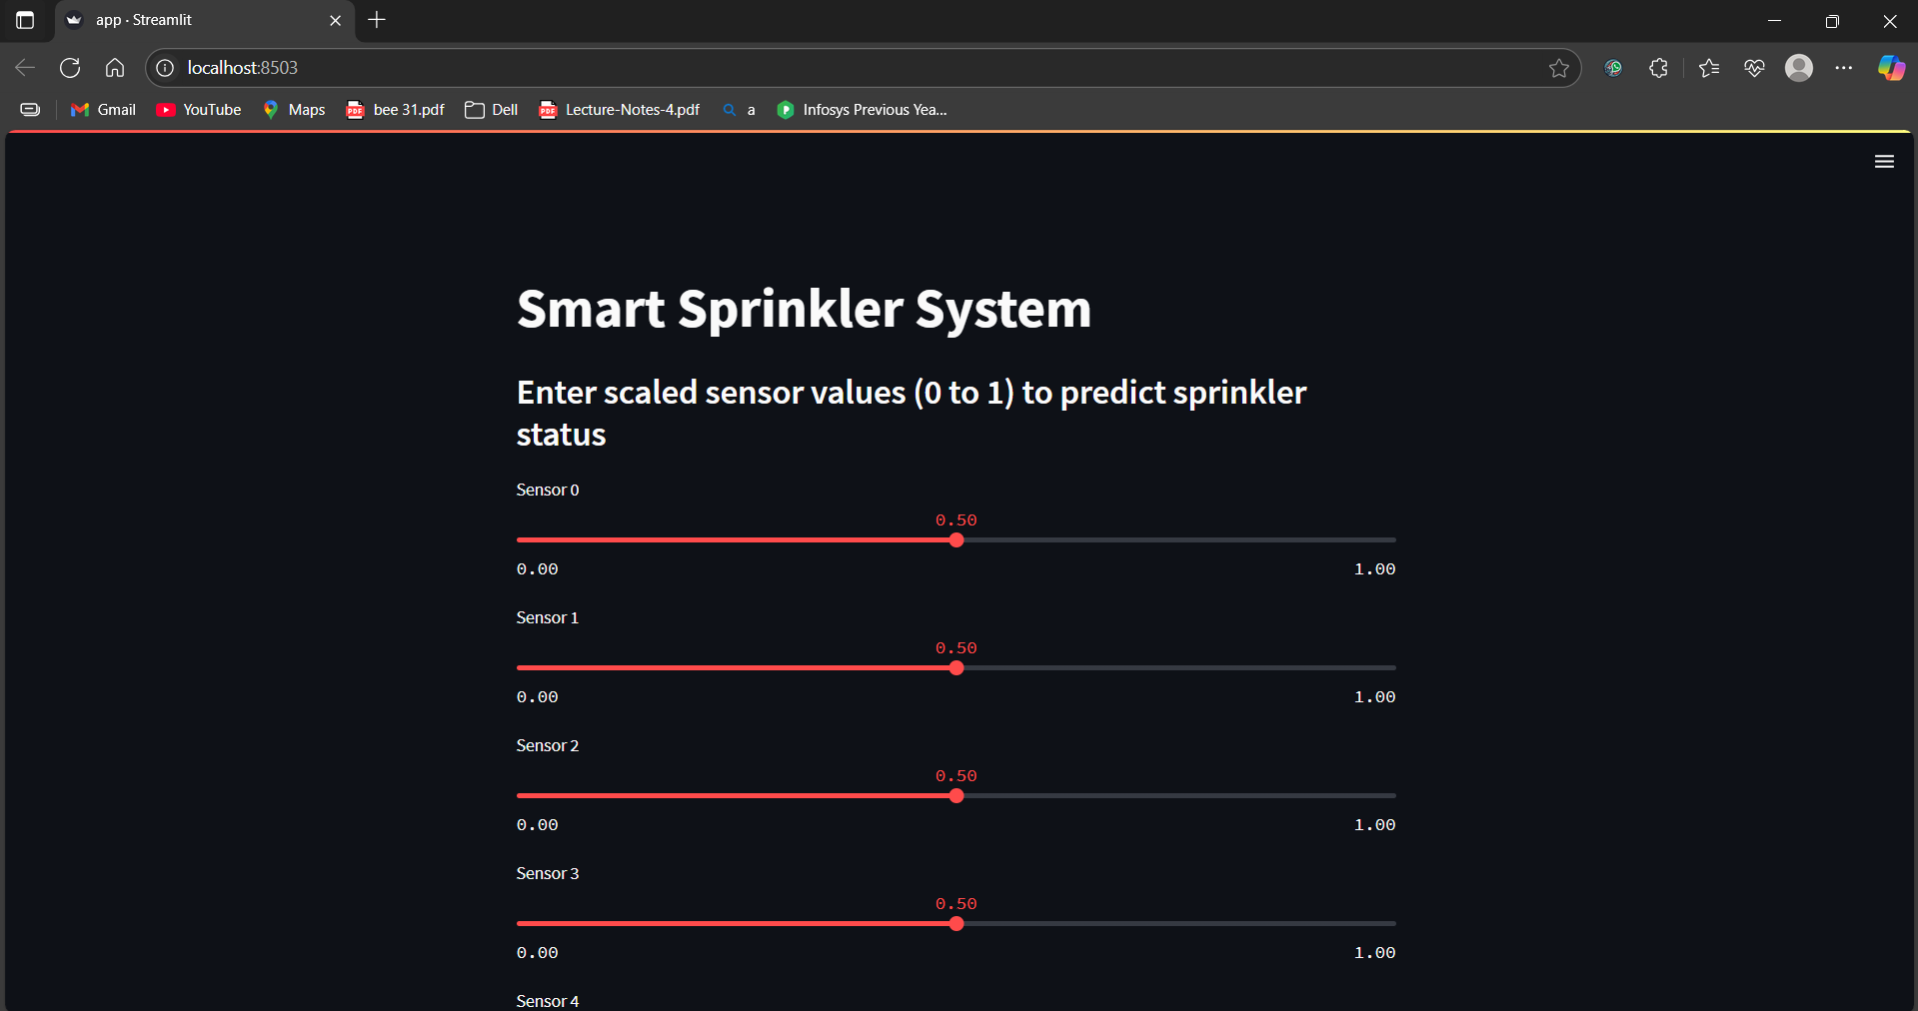
Screenshot of Output:
Streamlit App Interface

Slide 9
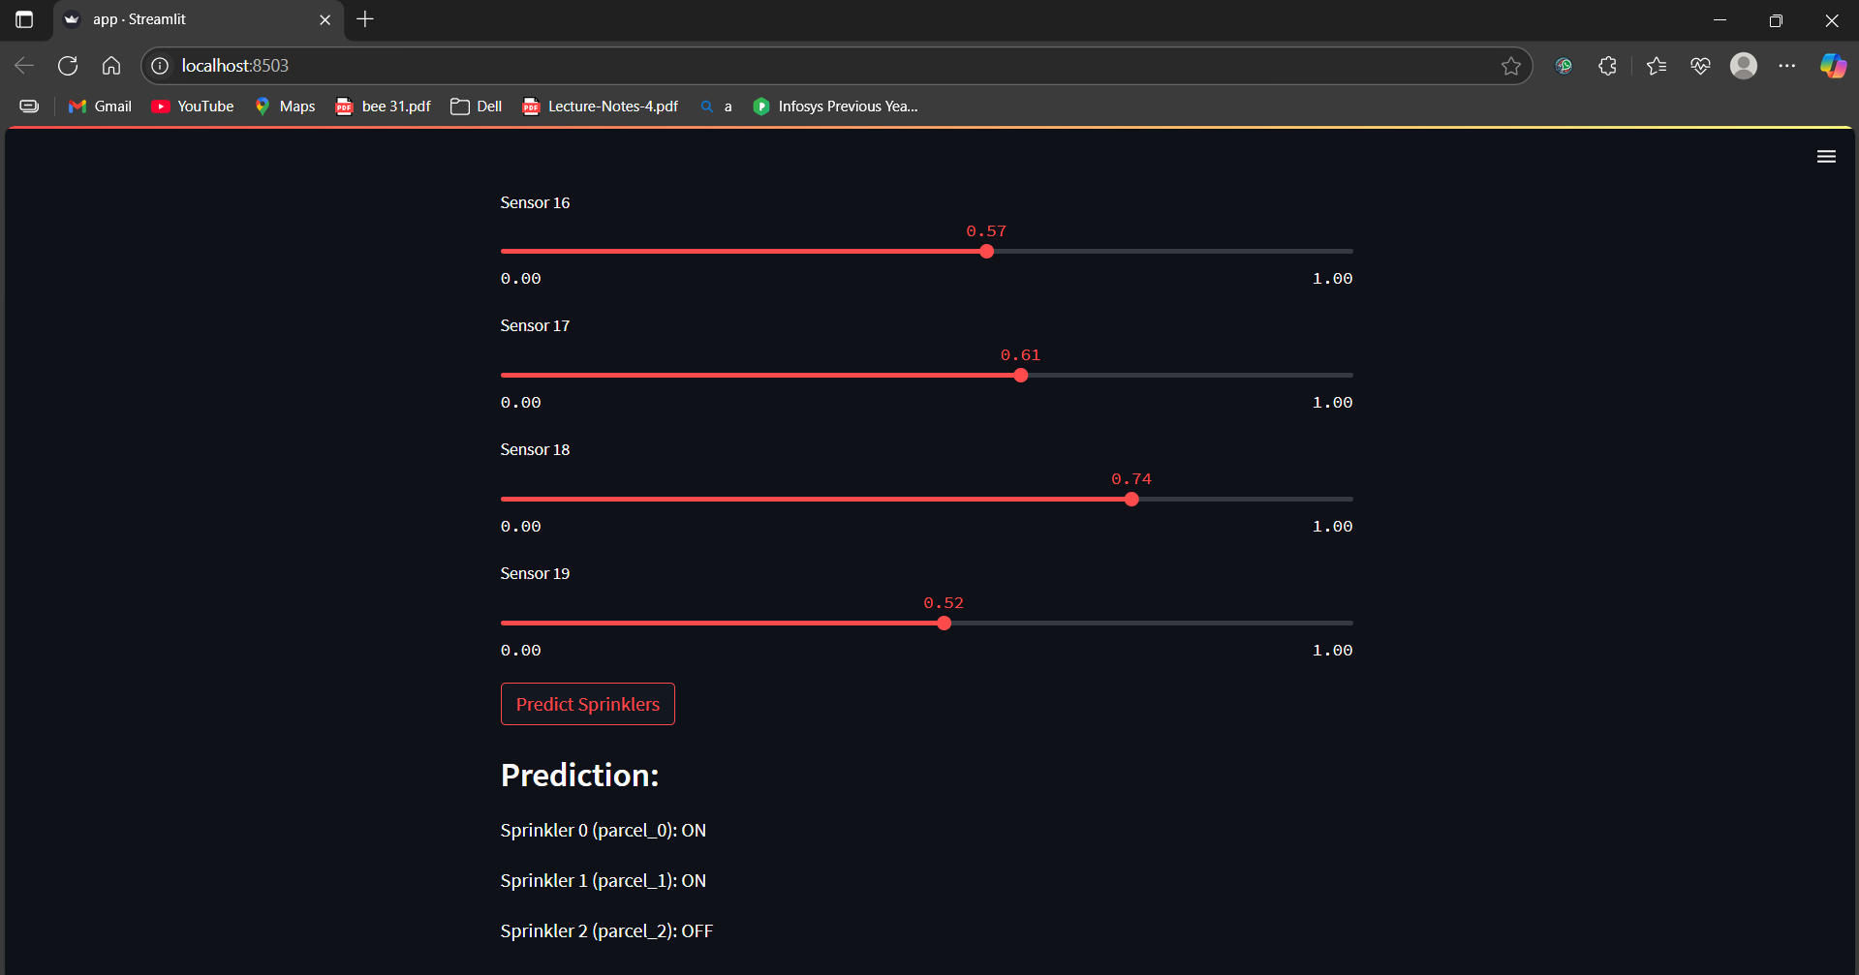
Screenshot of Output:
Prediction output (Sprinkler : ON or OFF

Slide 10
Conclusion:
We developed a Smart Irrigation System using Python and machine learning, where data from 19 sensors is used to predict the best crop and automatically control 3 pumps using ON/OFF switching logic.
The model was deployed through a Streamlit app, and the entire project, including code and
documentation, was managed on GitHub.
In the future, this system can be improved by connecting real-time IoT sensors, adding automatic alert messages for farmers, and deploying the app on the cloud for remote access and control.

